Slide 1
Meaning of Active high and Active low
Electronic circuits operate on voltages rather than logic levels
Every truth table has two interpretations in voltage levels
General concept:
Assume logic 1 is represented by a higher voltage than logic 0: called Active High or Positive Logic
To assert a signal, place a positive voltage on the wire and it is treated as a logic 1

Slide 2


active High and active Low
Alternatively:
A low voltage can be used to denote that a signal is asserted and high voltage when unasserted
Truth table comparison
Voltage truth table Positive Logic Negative Logic
F
A | B | F |  | A | B | F |  | A | B | F
Low | Low | Low |  | 0 | 0 | 0 |  | 1 | 1 | 1
Low | High | Low |  | 0 | 1 | 0 |  | 1 | 0 | 1
High | Low | Low |  | 1 | 0 | 0 |  | 0 | 1 | 1
High | High | High |  | 1 | 1 | 1 |  | 0 | 0 | 0

Slide 3
Meaning of “active” for inputs
For external inputs to a logic circuit we can adopt a view of active high/low with respect to the user’s assertion action
Typically, push the button is assertion and “active”
What voltage level is generated by asserting the button?
If low voltage w/ push, then user input is Active Low
If high voltage with push, then Active High

Slide 4
AcTiVe HiGh and AcTiVe LoW – I’m confused
Very real possibility of confusion
Avoid mixing positive and negative logic in a design when possible (Not always possible)
Can adopt the convention that gates are positive logic then
Place a “bubble” on an input or output that is to be asserted low
Label a signal as X’ if it is asserted with a low voltage

Slide 5
aCtIvE hIgH AND aCtIvE lOw
At the root of it all is duality in Boolean logic
=

Slide 6
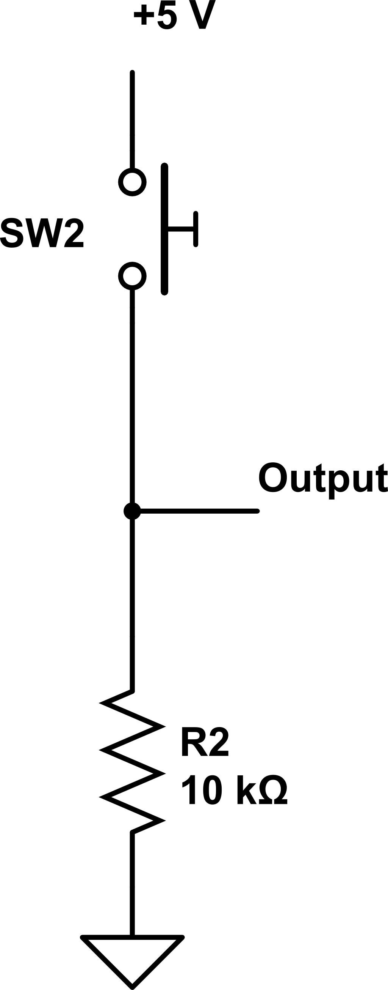
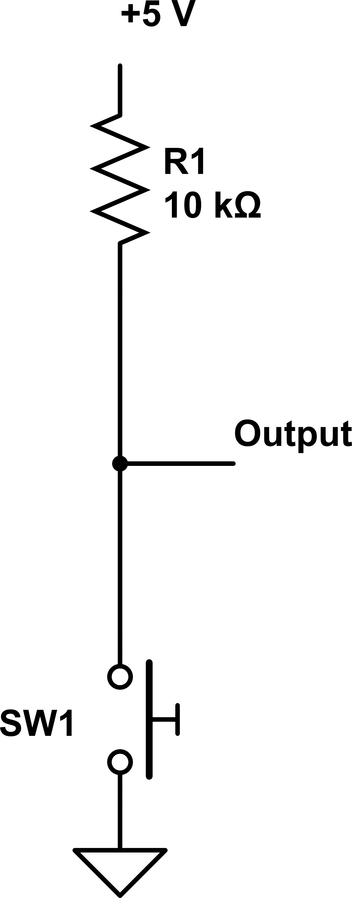
Active high & low mechanical switch input examples: push = assert input
Active high input: Active low input: Output = +5 V if push Output = 0 V if push

